Slide 2
Consume Graph APIs in SharePoint Framework
Jenkins NS

Slide 3












Jenkins NS
Modern Workplace Solution Architect | Consultant
Founder & Director @
Microsoft Teams, Power Platform and SPFx Specialist
International Speaker | Blogger | Trainer
SPS Bangalore Organizer
aOS Ambassador
jenkinsns@gmail.com
in/jenkinsns
@jenkinsns
http://www.jenkinsblogs.com
jenkinsns
https://www.facebook.com/spfxinfo/
https://www.facebook.com/msteamsinfo

Slide 4
Overview of MS Graph
Office 365 APIs
What is Graph API?
Consume Microsoft Graph
AadHttpClient object
MSGraphClient object
API permissions requests
Isolated web parts
Demo

Slide 5
Office 356 APIs
Service | Functionality | Base URL
Azure AD Graph | User, Groups Application, Devices | https://graph.windows.net
Exchange Online | Mail, Calendar, Contacts | https://outlook.office365.com/api
SharePoint Online | List, Libraries, Search, User Profiles | https://tenant.sharepoint.com/_api
OneDrive for Business | Files, Folders | https://tenant-my.sharepoint.com/_api
OneNote | Notebooks,Pages | https://onenote.com/api
Yammer | Conversations | https://yammer.com/api
Stream | Videos, Channels | https://tenant.sharepoint.com/portals

Slide 6



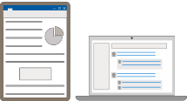
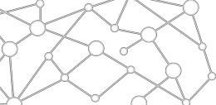

STANDALONE WEB, DEVICE, AND SERVICE APPS
Conversation are Core to the Office 365 Platform
EXTENSIONS


EMBEDDED CANVASES
Microsoft Graph
External Data & Content

Slide 7
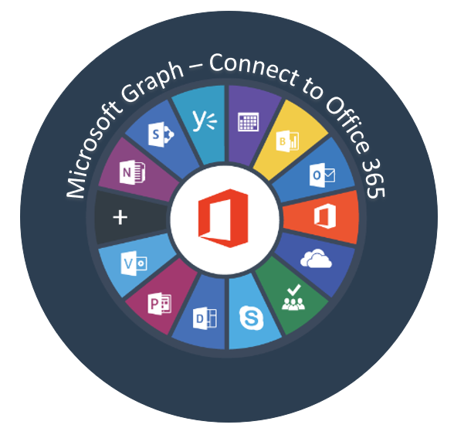
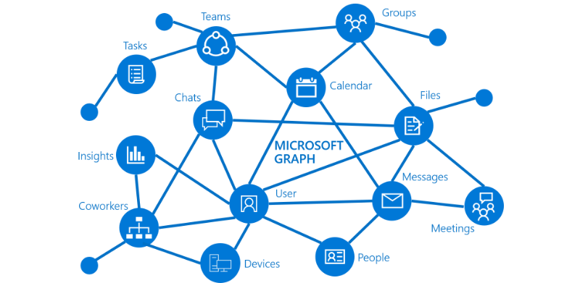
Overview of Microsoft Graph

Slide 8
What is Graph API?
Microsoft Graph exposes REST APIs and client libraries to access data on the following Microsoft 365 services:
Office 365 services: Delve, Excel, Microsoft Bookings, Microsoft Teams, OneDrive, OneNote, Outlook/Exchange, Planner, and SharePoint
Enterprise Mobility and Security services: Advanced Threat Analytics, Advanced Threat Protection, Azure Active Directory, Identity Manager, and Intune
Windows 10 services: activities, devices, notifications
Dynamics 365 Business Central

Slide 9
Microsoft Graph
Access user, group and organizational data
One endpoint One token
All users
Your App
https://graph.microsoft.com
Users
More…
#SPTechCon
Groups
SharePoint
Outlook
OneNote
Planner
Teams
Excel
Intune
Azure AD

Slide 10
Consume Microsoft Graph
You can now implement the below methods to consume the Microsoft Graph. You have two options:
Use the AadHttpClient client object
Use the MSGraphClient client object
SharePoint Framework v1.6.0 onwards supported consuming the MS Graph APIs and custom APIs.
Note:
SharePoint Framework v1.4.1 beta onwards MS Graph APIs supported.
You can consume the Microsoft Graph API with versions of SharePoint Framework earlier than v.1.4.1, either via the native graphHttpClient, or via a manual ADAL JS implicit OAuth flow.

Slide 11
AadHttpClient
AadHttpClient
The AadHttpClient client object is useful for consuming any REST API. You can use it to consume Microsoft Graph or any other third-party (or first-party) REST API and “AadHttpClient” is used to perform REST calls against an Azure AD Application, for example 3rd party WebAPI hosted in Azure.
For communicating with SharePoint, use the “SPHttpClient” class instead.
For communicating SharePoint with Microsoft Graph, use the MSGraphClient class.
this.props.context.aadHttpClientFactory
.getClient('https://graph.microsoft.com’)
.then((client: AadHttpClient) => {
// Search for the users with givenName, surname, or displayName equal to the searchFor value
return client .get( `https://graph.microsoft.com/v1.0/users?$select=displayName,mail,userPrincipalName&$filter=(givenName%20eq%20'${escape(this.state.searchFor)}')%20or%20(surname%20eq%20'${escape(this.state.searchFor)}')%20or%20(displayName%20eq%20'${escape(this.state.searchFor)}')`, AadHttpClient.configurations.v1
);
})
.then(response => {
return response.json();
})

Slide 12
MSGraphClient object
MSGraphClient
“MSGraphClient” is used to perform REST calls against Microsoft Graph. The Microsoft Graph JavaScript client library is a lightweight wrapper around the Microsoft Graph API. This class allows developers to start making REST calls to MSGraph without needing to initialize the MSGraph client library.
The MSGraphClient client object can consume the Microsoft Graph only. Internally it uses the AadHttpClient client object and supports the fluent syntax of the Microsoft Graph SDK.
Supported from SPFx v1.4.1 (Initial beta release of MSGraphClient class)
MSGraphClient is a new HTTP client introduced in SharePoint Framework v1.6.0
this.props.context.msGraphClientFactory
.getClient()
.then((client: MSGraphClient): void => {
// From https://github.com/microsoftgraph/msgraph-sdk-javascript sample
client
.api("users")
.version("v1.0")
.select("displayName,mail,userPrincipalName")
.filter(`(givenName eq '${escape(this.state.searchFor)}') or (surname eq '${escape(this.state.searchFor)}') or (displayName eq '${escape(this.state.searchFor)}')`)
.get((err, res) => {
if (err) { console.error(err); return; }

Slide 13
API Permissions
To consume Microsoft Graph or any other third-party REST API, you need to explicitly declare the permission requirements from an OAuth perspective in the manifest of your solution.
In the SharePoint Framework v.1.4.1 or later, you can do that by configuring the webApiPermissionRequests property in the package-solution.json under the config folder of the solution.
Microsoft Graph permission names follow a simple pattern: resource.operation.constraint..Read grants permission to read the profile of the signed-in user.
User.ReadWrite grants permission to read and modify the profile of the signed-in user and
Mail.Send grants permission to send mail on behalf of the signed-in user.
"webApiPermissionRequests": [
{
"resource": "Microsoft Graph",
"scope": "User.ReadBasic.All"
}
]
https://docs.microsoft.com/en-us/graph/api/resources/team?view=graph-rest-1.0
Notes:
https://docs.microsoft.com/en-us/graph/api/resources/team?view=graph-rest-1.0
https://developer.microsoft.com/en-us/graph/graph-explorer#
https://docs.microsoft.com/en-us/graph/permissions-reference

Slide 14
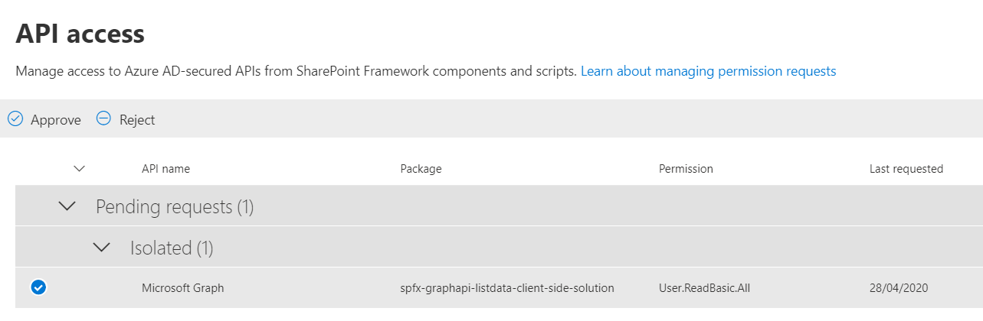
API access

Slide 15
Isolated Webparts

Slide 16
Why Isolated web parts?
To allow your SharePoint Framework solutions to securely access APIs secured with Azure AD, you can use the API management to specify which APIs can be accessed by scripts in your tenant and with which permissions.
Using the SharePoint Framework, you can easily retrieve an access token for the specific API.
While it significantly simplifies communicating with APIs secured with Azure AD, it allows all scripts, not just specific SharePoint Framework solutions, to obtain an access token for any of the approved APIs. If one of the scripts you use in your tenant was exploited, then it could access any of the approved APIs on behalf of the current user.
SharePoint Framework v1.8.0 onwards has addressed this situation by introducing isolated web parts
Isolated web parts introduce a new way to isolate access to APIs secured with Azure AD and ensure that only specific SharePoint Framework web parts are allowed to obtain an access token for the particular API.
If your web part requires permission to access any backend API or Graph, it is strongly recommended to have the web part isolated.
We should protect the access token which is used behind the scenes and make sure that no other script on the page will piggy-back the permissions we are using. Isolated web part is one step towards handling security concerns.

Slide 17
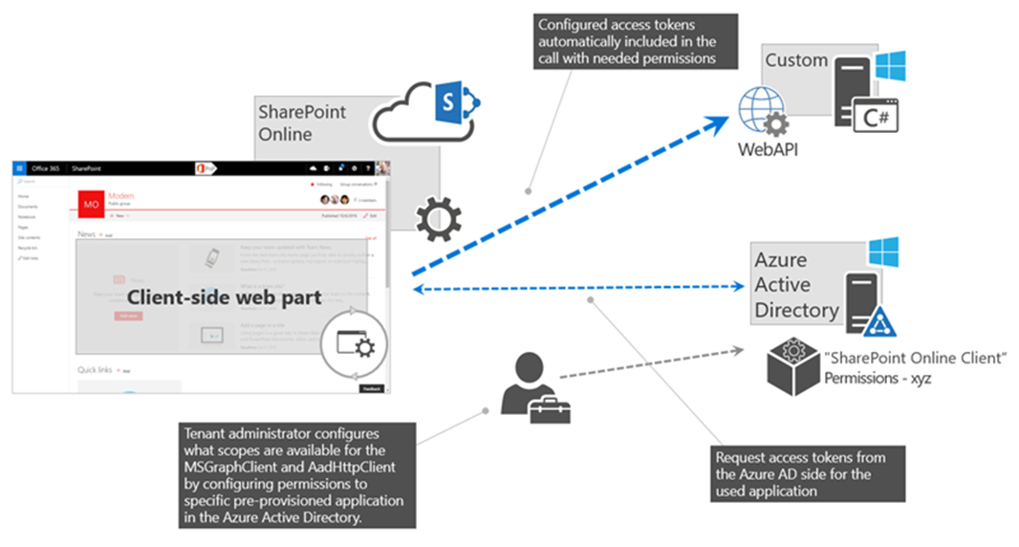
Isolated web parts

Slide 18
Isolated web parts benefits
Web parts from an isolated SPFx package run on a unique domain, hosted within an iFrame - the permissions granted apply only to code hosted on that domain.
Regular SPFx web parts run on your *.sharepoint.com domain, the granted permissions do not apply there.
And since any other SPFx isolated web parts run on a different unique domain, they don't apply there either.
Essentially, the shared application principal for SPFx is not used – instead, an AAD app registration dedicated to this SPFx solution is created and used for authentication.
Note this scope isn’t the individual web part, but the containing solution package.
This is fine however - if you have an untrusted source contributing code to the very same solution/codebase, then you probably have bigger security and governance challenges to deal with quite frankly.
In the ‘config/package-solution.json’ file, set the isDomainIsolated property to true.
"isDomainIsolated": true

Slide 19
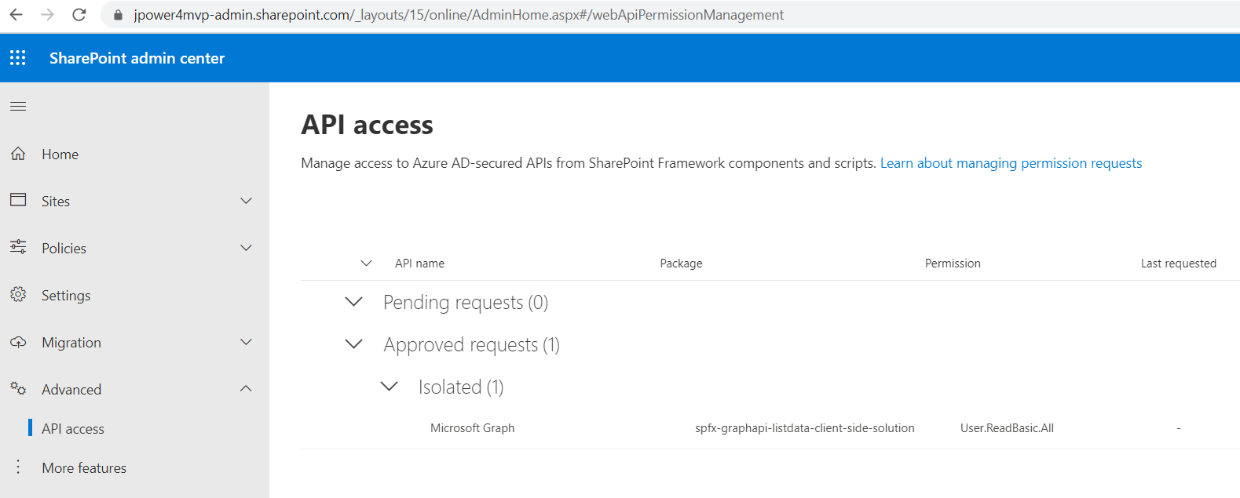


Slide 20
Consume Graph APIs in SharePoint Framework
- Using No JavaScript Framework
- Using React
Download the code
https://github.com/jenkinsns/spfx-demo-webparts

Slide 21
References…
http://jenkinsblogs.com/2020/04/29/retrieve-sharepoint-list-items-using-microsoft-graph-api-for-spfx/
https://developer.microsoft.com/en-us/graph/graph-explorer#
https://docs.microsoft.com/en-us/graph/api/user-get?view=graph-rest-1.0&tabs=http
https://docs.microsoft.com/en-us/graph/permissions-reference
https://docs.microsoft.com/en-us/sharepoint/dev/spfx/use-msgraph
https://docs.microsoft.com/en-us/sharepoint/dev/spfx/use-aad-tutorial
https://docs.microsoft.com/en-us/sharepoint/dev/spfx/web-parts/isolated-web-parts

Slide 23
Build Microsoft Teams customizations with SPFx
Kirti Prajapati

